Slide 1
Health Care Disparities for People with Disability and Potential Role of Physician Bias
Lisa I. Iezzoni, MD, MSc
Professor of Medicine, Harvard Medical School
Health Policy Research Center, Massachusetts General Hospital
February 25, 2021

Slide 2
No financial disclosures to report

Slide 3
CONTEXT
61 million Americans with disability and these numbers are growing
“Disability in America is not a minority issue … Disability affects today or will affect tomorrow the lives of most Americans.” (National Academy of Medicine, 2007)
30+ years since passage of the Americans with Disabilities Act
43+ years since regulations implemented under Section 504 of 1973 Rehabilitation Act

Slide 4
Why is it so hard to make health care fully equitable and accessible to people with disability?

Slide 5
Why in 2021 do people with disability still confront barriers and experience disparities in their health care?

Slide 6
ORGANIZATION OF TALK
Disparities: social determinants of health
Disparities: screening and preventive services
Physicians’ attitudes and perceptions: survey findings
Michael’s story

Slide 7
Social determinants of health

Slide 8
Social determinants of health – social factors that can affect physical and emotional wellbeing and ability to receive health care services. Increasing recognition of their role in population health.

Slide 9
SOCIAL DETERMINANTS OF HEALTH
Low incomes
Low education
High unemployment rates
Poor housing, inaccessible housing, and/or housing insecurity
Significant transportation problems
Food insecurity
Domestic violence, intimate partners, or caregiver abuse (men and women)

Slide 10
RACE/ETHNICITY INTERSECTIONALITY
Disability rates
24% for Whites
30% for Black Americans
31% for Hispanics
16% for Asians
25% for Native Hawaiians or Other Pacific Islanders
40% for Native Americans or Alaskan Natives

Slide 11
Coronavirus pandemic has underscored how minority populations are at risk of worse health outcomes. We know that racial and ethnic minority populations experience significant health care disparities.

Slide 12
Health care disparities

Slide 13
HEALTHY PEOPLE
Every 10 years, federal officials put together a road map for improving public health over the next 10 years – Healthy People
Healthy People 2010, published in November 2000, was first time people with disability were identified as experiencing disparities
Healthy People attributed these disparities partially to erroneous assumptions about the daily lives, values, and expectations of people with disability

Slide 14
Common misconceptions about people with disabilities contribute to troubling disparities in the services they receive, especially an “underemphasis on health promotion and disease prevention activities.”

Slide 15
Healthy People 2020, published in November 2010, also identified disparities for people with disability. Recommendations involved addressing social determinants of health.

Slide 16
PAP TEST RATES
No disability: 85%
Mobility difficulty: 78%
Sensory difficulty: 80%
Mental health difficulties: 74%
Cognitive difficulties: 76%
Self-care limitations: 68%

Slide 17
PAP TEST RATES BY MOBILITY DISABILITY LEVEL
No difficulties: 85%
Least severe difficulties: 82%
Level two: 80%
Level three: 78%
Level four: 72%
Most severe difficulties: 65%

Slide 18
Women with major mobility difficulties are 70% less likely to be asked by their physicians about their need for contraception.

Slide 19
STAGE 1 BREAST CANCER TREATMENT
SEER data merged with Medicare data
All women < age 65 with Stage 1 breast cancer
62% of women without disability got breast conserving surgery compared with 54% of women with disability
After accounting for age at diagnosis, race, ethnicity, tumor characteristics, and other factors, women with disability 24% less likely than other women to get breast conserving surgery

Slide 20
AFTER BREAST CONSERVING SURGERY
Equivalent outcomes as mastectomy if women with early stage breast cancer follow up with radiation therapy
Looking only at women < age 65 with breast conserving surgery, women with disability 17% less likely to get radiation therapy
Women with Stage 1 breast cancer and disability 45% more likely to die of their breast cancer than other women

Slide 21
POTENTIAL CAUSES OF DISPARITIES
Patients’ complex underlying health conditions and competing priorities
Disadvantages in social determinants of health
Patients’ preferences for care
Inadequate training of health care professionals
Ineffective communication accommodations
Inaccessible medical diagnostic equipment, including weight scales and exam tables
Inadequate knowledge about ADA mandates for equitable care
Erroneous assumptions about people with disability
Ableism attitudes among clinicians

Slide 22
Physicians’ attitudes and perceptions

Slide 23
NATIONAL SURVEY OF PRACTICING PHYSICIANS
First national U.S. survey of practicing physicians and their experiences with and perceptions of caring for people with disability
Funded by Eunice Kennedy Shriver National Institute of Child Health and Human Development
Because if was first national survey, we tried to cover wide-ranging topics: went shallow, not deep
Results here about physicians’ perceptions
Published in Health Affairs, February 1, 2021

Slide 24
THANKS TO RESEARCH TEAM
Massachusetts General Hospital
Sowmya R. Rao, PhD (statistician)
Karen Donelan, ScD, EdM (survey scientist)
Nicole D. Agaronnik, BS
University of Colorado, Anschutz Medical Campus (Aurora, CO)
Eric G. Campbell, PhD (survey scientist)
Julie Ressalam, MPH, CHES
University of Massachusetts-Boston, Center for Survey Research
Dragana Bolcic-Jankovic, PhD (survey scientist, led survey administration)
Baystate Health, Springfield, MA
Tara Lagu, MD, MPH

Slide 25
PHYSICIAN SPECIALITIES
Internal medicine/general internal medicine
Family practice
Rheumatology
Neurology
Ophthalmology
Orthopedic surgery
Obstetrics/gynecology

Slide 26
SURVEY DEVELOPMENT
Conducted in-depth individual interviews with 20 practicing physicians in Massachusetts
Conducted 3 focus groups with 22 practicing physicians total across 3 states
Identified key topic areas for survey
Designed survey iteratively
Conducted 8 cognitive interviews and 50 pilot tests of draft survey
Final survey: 8 modules, 75 questions – again, broad but not deep

Slide 27
CONDUCTING SURVEY
Randomly sampled practicing physicians from national list
Eliminated trainees, VA physicians, locum tenens physicians, physicians no longer practicing, etc.
Sampled 350 physicians in each primary care specialty + 140 physicians in each of the 5 specialties = 1,400 total in sample
CSR mailed paper survey in October 2019, with $50 bill inside
Also offered option to answer survey on line
Final follow up complicated by pandemic in Spring 2020
Response rate: 61%

Slide 28
Many findings on various topics. Focus here on physicians’ perceptions of caring for people with disability.

Slide 29
MAIN FINDINGS
82% of physicians report that people with significant disability have overall worse quality of life than other people
41% of physicians are very confident in their ability to provide equal quality care to people with disability
56% strongly welcome people with disability into their practices

Slide 30
OTHER FINDINGS
18% of physicians strongly agree that people with disability are often treated unfairly in the health care system
80% strongly agree that understanding their patients with disability is very valuable

Slide 31
MULTIVARIABLE ANALYSIS: QOL
Women physicians much LESS likely than men to report worse quality of life for people with disability
Safety-net physicians much less likely than non-safety net physicians to report worse quality of life for people with disability

Slide 32
MULTIVARIABLE ANAYSIS: WELCOMING PWD
Women physicians much more welcoming than men
Some racial/ethnic differences, but samples for under-represented minorities too small to evaluate fully
Older physicians much less welcoming than younger physicians
Physicians in private practice much less welcoming than physicians at teaching hospitals
Physicians who value understanding patients with disability much more welcoming
Physicians who feel very confident about ability to provide equal quality of care much more welcoming than other physicians

Slide 33
DISCUSSION #1
Social desirability bias not evident (survey gave physicians option to say people with disability have same – or better – QOL)
Response about worse quality of life suggests strong confidence in their answer (i.e., that no one would argue with their response)
Raises question about care for people with disability in times of scarce resources: COVID-19 pandemic
Given potential bias of physicians, how do we ensure that people with disability get equal quality care

Slide 34
DISCUSSION #2
Only 41% of physicians feel confident in ability to provide equal quality care to people with disability
Those who do not feel confident are less welcoming of people with disability in their practices
30+ years after enactment of Americans with Disabilities Act, troubling that less than half of physicians feel confident about providing equal quality care
Clearly, this must be addressed – but how quickly can that happen?

Slide 35
Why should patients with disability need to prove to their doctor that they value the quality of their life to get equal quality care?

Slide 36
Michael’s story

Slide 37
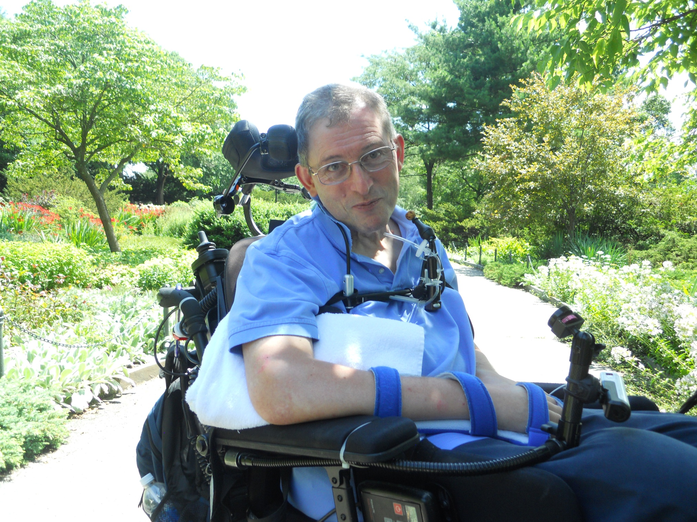

Slide 38
MICHAEL
61 years old, 21 year history of primary progressive multiple sclerosis (PPMS)
Born Birmingham, England; DPhil physics Oxford University
Excellent physical health: high altitude, long distance cyclist; became avid speed skater and cross country skier after moving to North America in 1981 for post-doc at Cornell
PPMS diagnosed at age 42; needed wheelchair in 7 years
Complete quadriplegia; cannot move his body volitionally below his neck

Slide 39
4,125 km (≈ 2,563 miles) on wheelchair odometer after 3.5 years of use

Slide 40
MICHAEL’S CARE PROVIDERS
To obtain required PCA services and other reasons, Michael enrolled in PACE (Program for All-Inclusive Care of the Elderly)
Nursing home-certifiable, Medicare, ≥ age 55
Most members transported from home to adult day care, returning to family at night
Must exclusively use PACE physicians
Some PACE leaders did not want him because he lives alone; they thought he should be in nursing home
Worked well: PCA coverage 10 hours/day, home nursing daily
Michael did not attend PACE adult day care, preferring to be active in his community

Slide 41
MICHAEL’S CANCER #1
March 2015, started complaining of:
Loss of appetite
Early satiety
Occasional vomiting and nausea
Reduced food intake
Change in bowel patterns
Lower abdomen grew distended
He asked PACE repeatedly for gastroenterology evaluation, but NP failed to schedule

Slide 42
MICHAEL’S CANCER #2
May 2015: blood pressure rose to 160/100-110, despite previously normal values; not controlled by medication
June 2015: started having trouble saying more than several words before needing to take a breath
Early July 2015: PACE primary care MD visited him at home for 6-month check up, but did not examine him saying he could not get Michael out of his wheelchair
Didn’t even lift up his shirt

Slide 44
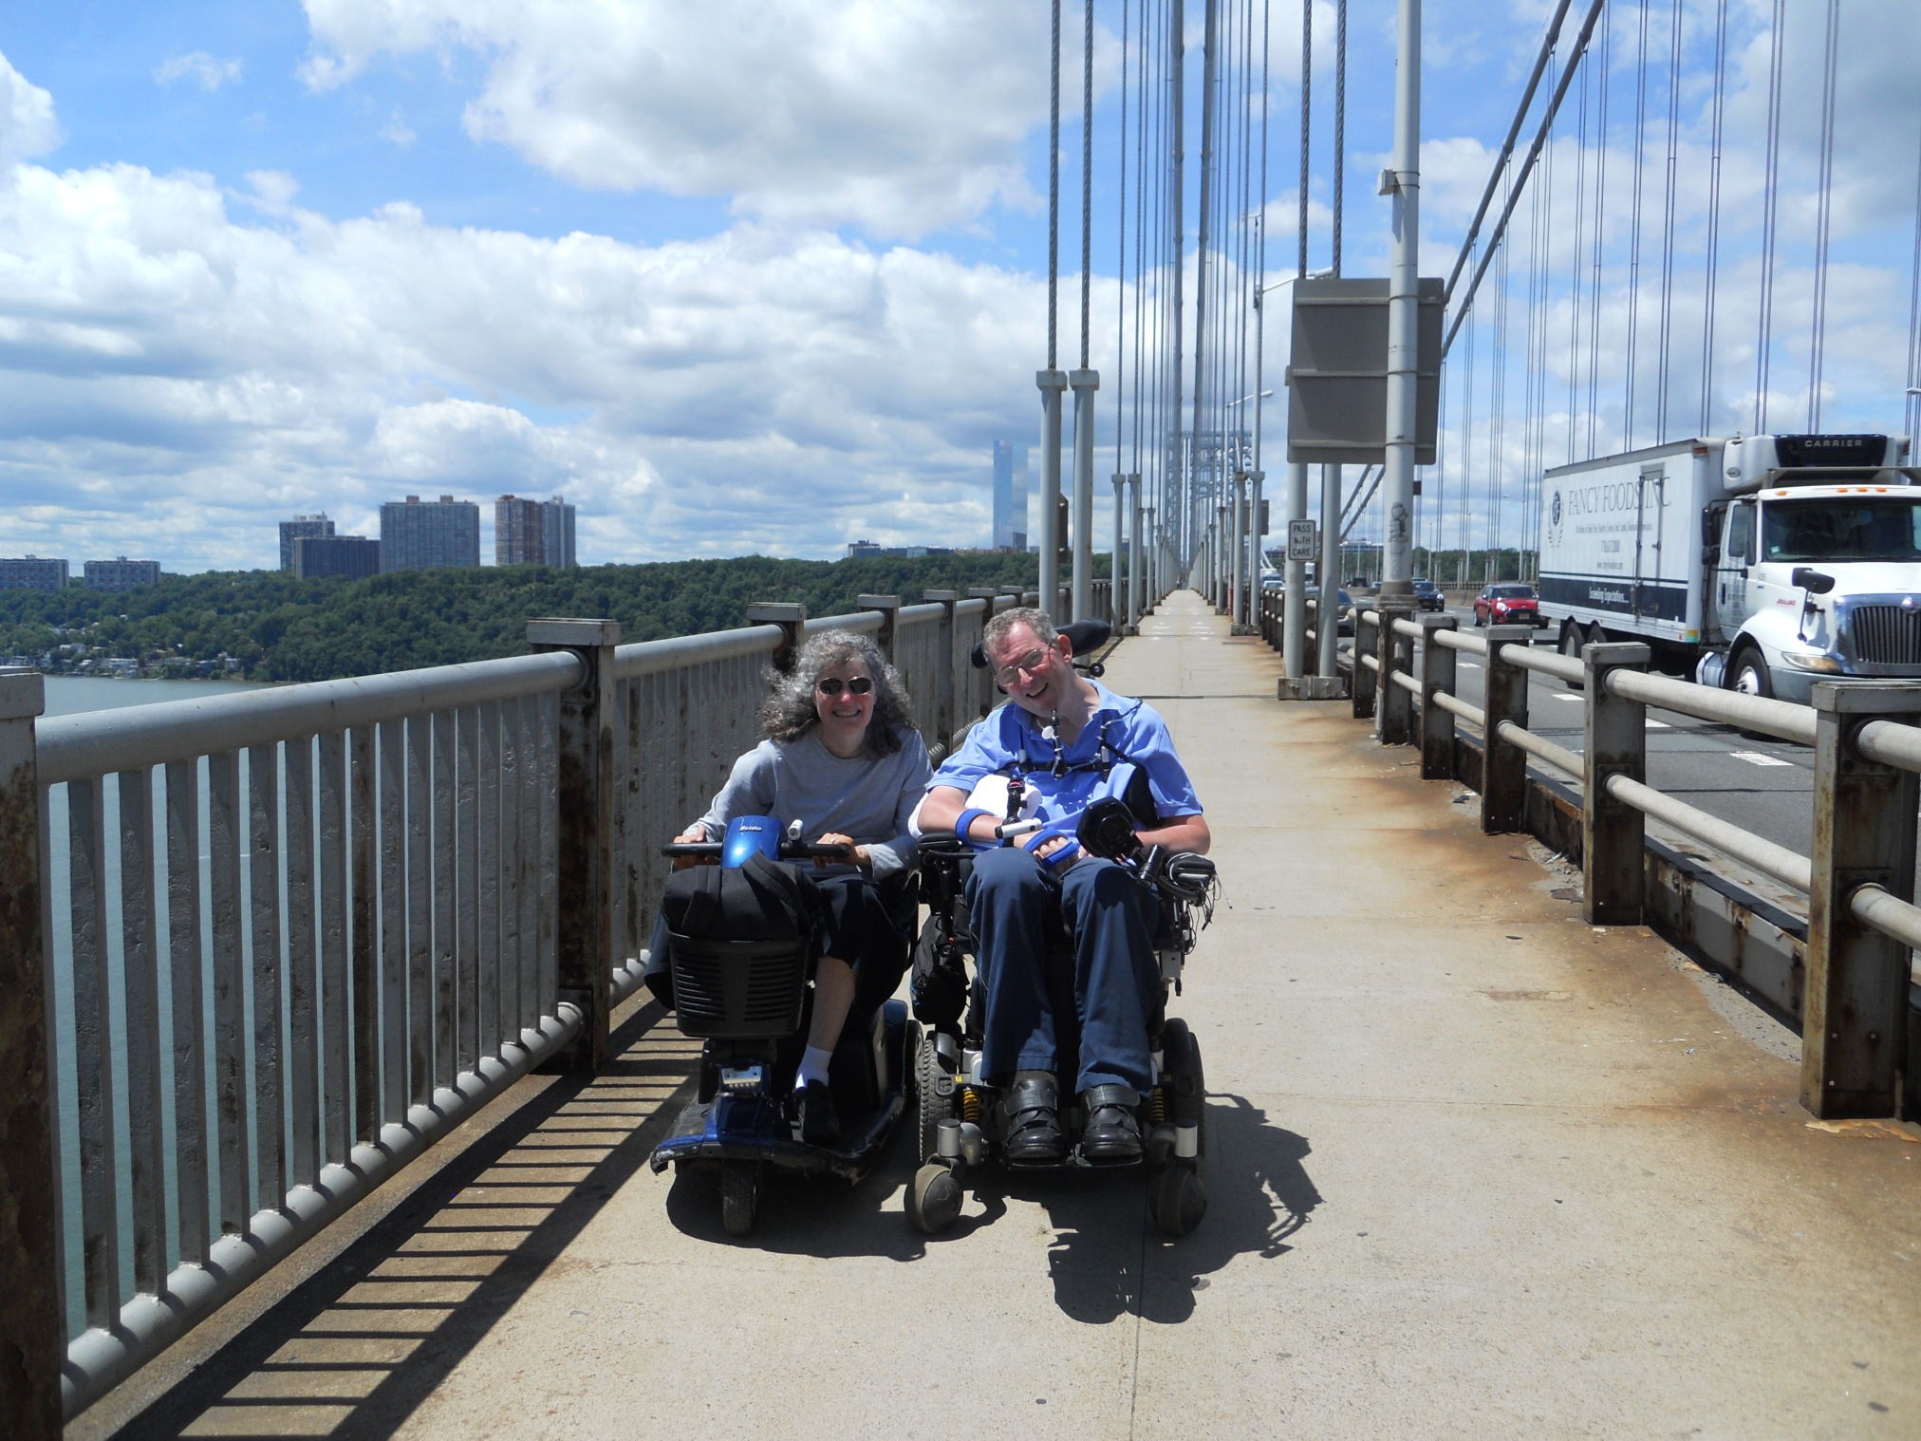

Slide 45
MICHAEL’S CANCER #3
My mid-July Michael’s birthday visit
Haggard, unable to eat, vomited even small meals, difficulty talking, hugely distended lower abdomen, edematous legs
I got Michael’s permission to actively advocate for him with PACE
Following Friday, Michael had CT scan

Slide 46
MICHAEL’S CANCER #4
Over weekend after CT scan, had fever of 102°, could not eat
Visiting nurse prescribed Tylenol
Early Monday: I telephoned PCP to find out results of Friday’s CT scan
Lower abdominal mass
I insisted he be treated at a major academic medical center in nearby city rather than their affiliated community hospital

Slide 47
MICHAEL’S CANCER #5
When admitted, found to have bilateral femoral vein clots
July 30, 2015: Michael had a 15-pound gastrointestinal stromal tumor (GIST) removed and IVC filter placed (to prevent clots from reaching his lungs)
His blood pressure fell to normal
His breathing returned to baseline pattern
Takes daily imatinib – fortunately, no side effects
56 months later, tumor free

Slide 48
MICHAEL’S CANCER #6
Clearly, he got substandard care.
But was there more going on?
Home care nurse thought he was getting fat because he does not exercise.
Diagnostic overshadowing
MS does cause constipation. Was abdominal distension caused by stool?
Severe MS can cause breathing problems.
No relationship between MS and hypertension.

Slide 49
Social worker admitted that palliation is PACE’s goal: he is so “very disabled” that, for Michael, their primary goal was “palliation” rather than active exploration and intervention as needed. Hopefully, this attitude is rare, but maybe not ...

Slide 50
Why should patients with disability need to prove to their doctor that they value the quality of their life to get equal quality care?

